Slide 1
Foundations of Computer Science for Researchers

Slide 2
Goals for this lesson
Big picture stuff--what is a programming language? What do programs do?
Differences between programming languages
What are the most commonly used languages?
Why Python?
Programming environments
Compiler versions.
IDEs (integrated development environment).
Reproducibility--GitHub, BitBucket, Atlassian, etc.
Start programming!

Slide 3
Class goals
Grasp fundamentals of computer programming
Computational tools
Data structures
Syntax
Apply fundamentals to other programming languages
Ask the right questions for the next steps

Slide 4
Programming languages
What are they?
Automates and executes algorithms in a structured format.
So what is an algorithm?
A series of instructions constructed to solve a problem.
Examples: instructions on the back of your cake mix, manual for assembling furniture, and so forth.
Some problems cannot be solved using an algorithm--undecidable, unsolvable, intractable problems.
Usually serves as an intermediary between natural languages and assembly language.

Slide 5
Programming languages
How do they compare to natural languages?
Formally defined syntax and semantics. Will often have a lexicon of keywords.
Unambiguous. Computers cannot resolve ambiguity like humans can.
Must be implementable.
Turing complete
Replicability, predictability, consistency.
For all Turing machines T and input i, there exists a result r, such that all machines T and i will produce the same r.
Arithmetic rules stipulate that 2 + 2 must always yield 4.

Slide 6
Programming languages
What do programs do?
Almost everything.
“There are more things in heaven and earth, Horatio, than are dreamt of in your philosophy.” (from Shakespeare’s Hamlet). Limitations are set by the extent of your knowledge and imagination.

Slide 7

Programming languages
For each day in month:
print(day)
eat()
exercise()
read()
learn()
Programmer (that’s you)
?
Computational problem
Write a program!

Slide 8
Types of programming languages
High-level languages
More similar to natural languages than low-level languages.
Handles computational problems designed by programmer.
Constructs represent mathematics.
C++, Java, Python, MATLAB, Javascript, C#.
Low-level languages
Languages which communicate instructions to computer microarchitecture.
Pertains to hardware underlying your software.
Several levels removed from the user.
Assembly language, machine language, and some say C...

Slide 9
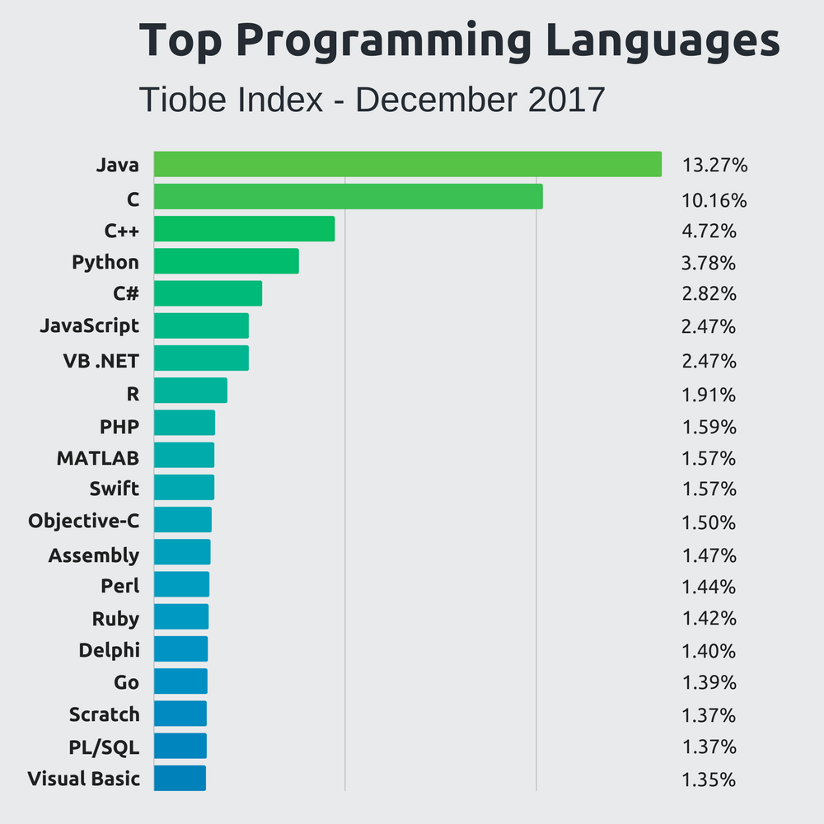
What are common languages out there?
Stackify 2018

Slide 10
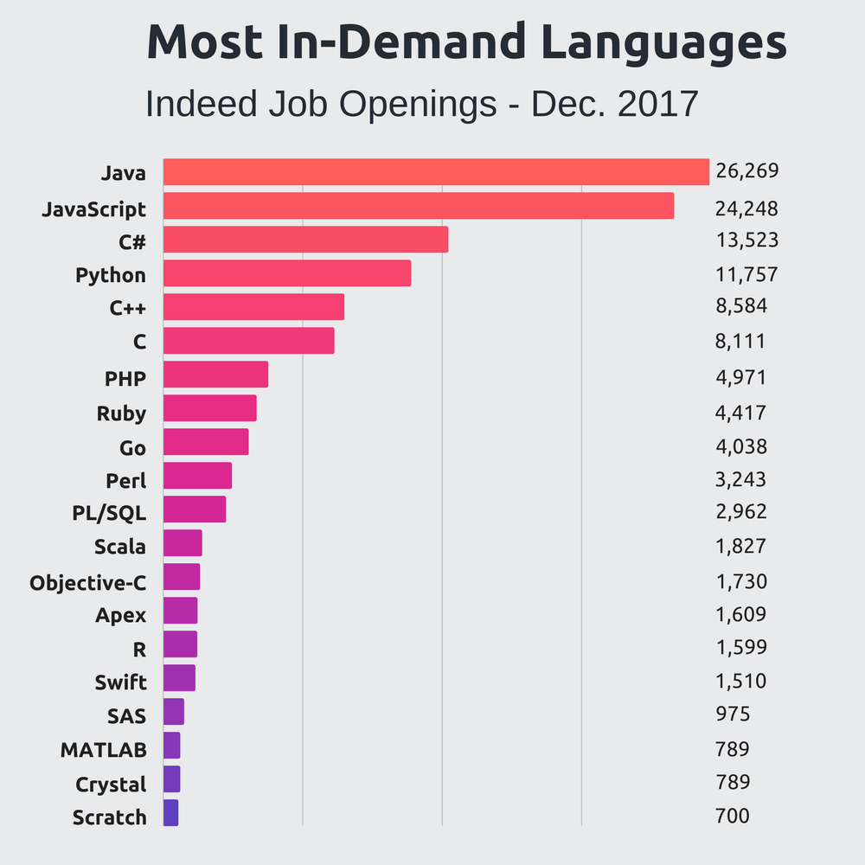
What are common languages out there?
Stackify 2018

Slide 11
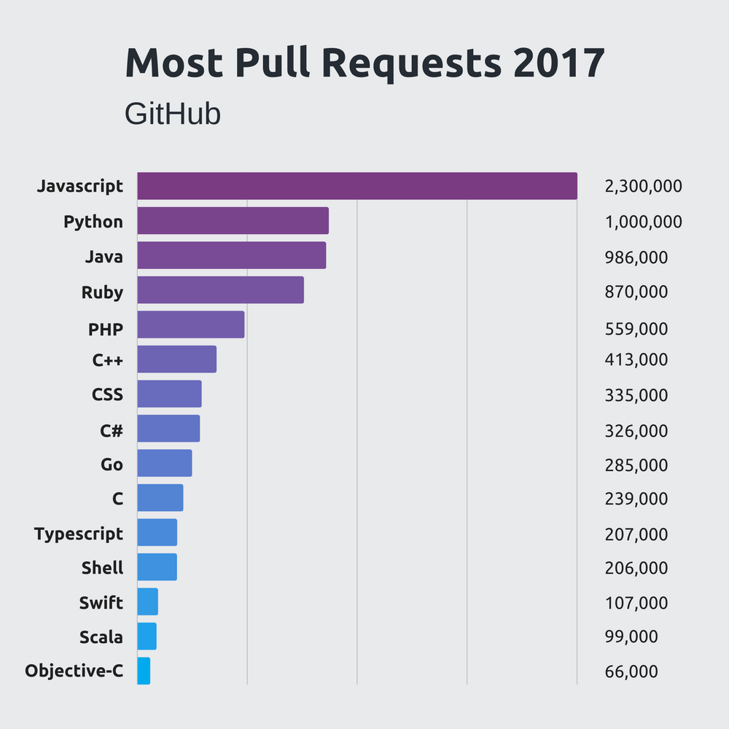
What are common languages out there?
Stackify 2018

Slide 12
Which language should I choose?
Functionality
Data analysis, machine learning → Python, MATLAB
Software development and engineering → Java, C, C++
Hardware manipulation → C
Database management, querying → SQL, MySQL, PostGres
Web development → Javascript, C#

Slide 13
Why Python?
Functionality
Fundamentals of computer science made easier with Python.
Machine learning libraries for data science projects in future.
High demand and usage in academia and industry
Open-source, free of cost
Extensively documented
Important for troubleshooting…

Slide 14
Programming Environments

Slide 15
IDE (Integrated Development Environment)
Supports only a few select programs per IDE
We will use PyCharm, which only supports Python.
NetBeans and IntelliJ support Java.
Xcode, built for Mac, is for Java, C++, C.
Organization
One project may have more than one program for modularity purposes.
Multiple projects in same IDE.
Debugging
No one writes a perfect program in his/her/their first pass.
Set breakpoints to see which values are being changed as the program executes.

Slide 16
Compilers
Each language has multiple versions of its own compiler
Translates high-level programs into machine-readable format
Checks syntax
Kind of like a spellchecker, they pick up on syntactical errors before programs are executed.
Compiler errors
Throw errors if incorrect syntax is detected.
Usually cannot execute programs with compiler errors.
More on this later...

Slide 17
Saving and Reproducing Code
SAVE YOUR CODE
Cloud servers such as the lab DropBox account
Google Drive
There are no excuses for lost code these days….
GitHub
Programmer’s preferred way of storing, sharing, and viewing code from other programmers.
Social media for programmers.
This is how you show off your code.
Get an account for next time.

Slide 18
Open Discussion
Which topics interest you most?
How were the slides?
Would you like to learn about anything I mentioned in more depth?
How should I structure classes to be most conducive to learning how to code?
Is there anything you didn’t understand?
How should we handle homework assignments and readings?

Slide 19
Foundations of Computer Science for Researchers
Week 2

Slide 20
Progress
Any questions from last week?
GitHub accounts
Caroline: guidodarezzo
More resources for coding practice
LeetCode
HackerRank
Reading
MIT OCW (Opencourseware)
https://ocw.mit.edu/courses/electrical-engineering-and-computer-science/6-00-introduction-to-computer-science-and-programming-fall-2008/readings/
John Guttag’s Introduction to Computation and Programming Using Python was my first intro CS book.
Updated versions
Data science version?
IDE issues?
Notes:
*note: for whatever system you are working on, check the version that you are compiling in.
For example – Some issues may have arisen from some using python 3 versus 2.7 (we are using 2.7 for this class)

Slide 21
Goals for this lesson
Functions
Purpose
Introduction to a function call
Print statements
Input function
Variables
Basic math operations
Adding your code to GitHub

Slide 22
Purpose of a function
In CS and Math, a function is a series of operations, performed on an input, which produces an output of some kind.
Familiar version from math
Parabolic function: f(x) = x²
x is the input, the product of x² is the output, and the given operations call for multiplication.
Same idea, different representation in CS
Different languages, slightly different representation.
Basic structure of a function is shared throughout most languages.
f(x) is the name of the function.
x is an argument that we pass to the function (parameter passing).
Parentheses denote beginning and end of parameter.
Operations are written inside of the body of the function.
Outputs are stored in memory or printed to the console.
Notes:
Functions can be defined by the user and inside the language itself.
Libraries – many have predefined functions, so spend time knowing how to grab the pre-defined rather than trying to create it
**Multiple parameters can be in the parameter that you are passing through -> separated by commas

Slide 23
Function call
Act of invoking a function
Programmer must decide on its use
When to invoke.
Which arguments to pass (parameter passing).
Where to store output.
Notes:
The function will not do anything until the user bring it up to front
Bringing a function into use = “calling it”

Slide 24
Print function in Python
Console output
Means whatever you decide to print will appear on your screen.
Super useful for debugging, FYI…
Arguments
0 or more
Strings
Anything enclosed in a single apostrophe, quotation mark, triple quote, or triple apostrophe.
Examples:
print(‘Hello, world’)
Print(“Hello, world”)
print(“””Hello, world”””)
print(‘’’Hello, world’’’)
Finish what you’ve started!
Close your parentheses and quotes.
Notes:
If you print 0 arguments, a blank line will be printed
The print function defaults to printing strings (*IMPORTANT TO KEEP IN MIND FOR TYPE CASTING IN LECTURE 3 AND 4)
Fun fact: where did the phrase “hello, world” come from?
Created by Brian Kernighan, author of the most widely read computer programming books.
Fun fact 2: People generally accept that the first programmer is Ada Loveless (WOMAN),
Wrote the world’s first machine algorithm from an early computing machine -> described an algorithm to compute Bernoulli numbers
Poet Lord Byron only legitimate child.

Slide 25
Print function in Python
Formatting
Print on multiple lines.
Choose separator.
Python default is a space.
Can be anything.
Choose line ending.
Python default is a carriage return.
Also can be anything.
Demo on different ways to format print statements.
Notes:
In python the default separator is a space and default line ending is a carriage return (but this can be specified to be anything)

Slide 26
Print statement problems
Print: Hello, world!
Print: Welcome to “Foundations of Computer Science”
Print: abc+def
Print: a^b^c^+d*e*f*#

Slide 27
Debug print statements
print(a”,”b”,”c”)
print(‘fizz’,’buzz’
Notes:
Answers:
Print(“a”, “b”, “c”)

Slide 28
Variables
Places in memory to temporarily hold value
Can be many types of values
Strings
Integers
Floating points (decimals)
Characters (individual alphanumeric values and symbols)
Declare
Create a space in memory for the variable and its contents
Initialize
Assign value to that variable/place in memory
What happens when we try to access a variable that has yet to be initialized?

Slide 29
Variable problems
Print out the following message: My name is [your name], and I have lived in [your city] for [number of years] years.
Declare and initialize variables representing your name, location, and number of years lived in that locale.

Slide 30
Debug variable problems
Just to drive the point home…
print(your_name)
your_name = “Caroline”

Slide 31
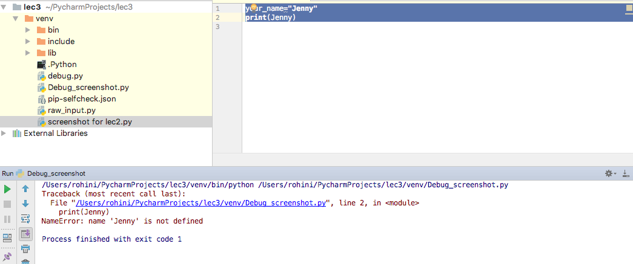
What is wrong?
Notes:
What happened here!?
You have declared the VARIABLE: your_name
You have initialized it by assigning a value to the variable: Jenny
Why does this not work:
What you are asking the print function to do is operate on the Jenny as if Jenny was the VARIABLE.
Rather, you have to pass the variable name itself (not the value assigned).

Slide 32
Foundations of Computer Science for Researchers
Week 3

Slide 33
Goals for this lesson
Wrap up print statements
Intro to errors
Input function
Storing user input as variables
Basic math operations
Type casting

Slide 34
Print statement wrap-up
Clarifying misinformation…
Printing strings interspersed with variables
variable = “Caroline”
print “My name is ”, variable
Printing without variables
print(“My name is Caroline”)
Sorry guys, exposed you to Python 3 syntax…
Please use a web compiler for last week’s lessons...Python3 web compiler
Notes:
WHY DO YOU NOT INCLUDE PARANTHESIS WITH MULTIPLE VARIABLE AND STRING?
Highlighting the compiler differences between 2 and 3
IE anytime you need comma, do not use parenthesis

Slide 35
Errors
Syntax errors
Code does not compile.
Violates rules of the language.
Caught BEFORE executing code.
Runtime errors
Code compiles, but throws errors while executing it.
File input/output issues, division by zero, etc.
Caught DURING execution.
Logic errors
Hardest to detect because it doesn’t always throw errors.
Programmer did not handle exceptions properly….
Notes:
Logic errors:
Often the behavior of the program that the programmer did not want
Every time you have a stored as a variable and have inclination that things can go off -> create a print statement and see if produced what you wanted

Slide 36
Errors
Syntax errors
Code does not compile.
Violates rules of the language.
Caught BEFORE executing code.
Runtime errors
Code compiles, but throws errors while executing it.
File input/output issues, division by zero, etc.
Caught DURING execution.
Logic errors
Hardest to detect because it doesn’t always throw errors.
Programmer did not handle all necessary exceptions.

Slide 37
raw_input function
What happens when we can’t hardcode values for variables?
Need user input to determine value.
In other languages, such as Java and C++, this is called standard input.
Python handles console input as a function in which arguments represent the values assigned to the variable that stores the input.
var1 = raw_input(“What is your name? ”)
var1 = [Whatever the user inputs]
print “Welcome to computer science,”, var1
Default datatype is string.
What if we wanted an integer or float?
Need to type cast
Notes:
Raw_input function – takes input from console
Really helpful when you can’t predict what the value should be, so you need to query the user as to what is is and store that!
This allows you to DYNAMICALLY UPDATE the variable rather than simply defining it.

Slide 38
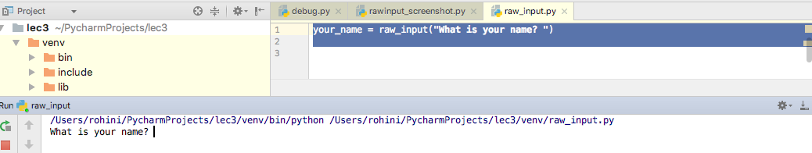
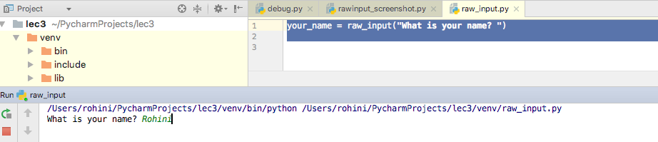
Python Code
Notes:
Top: How the code looks like for raw_input. You are still declaring the VARIABLE for a name, but now rather than defining it you are asking the user to input by the function raw_input
Bottom: How the console looks like when you want to enter the value

Slide 39
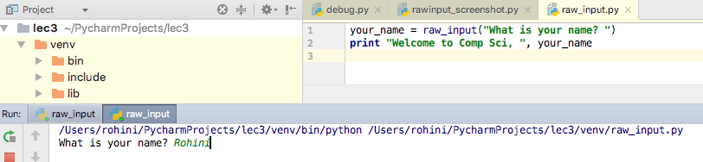
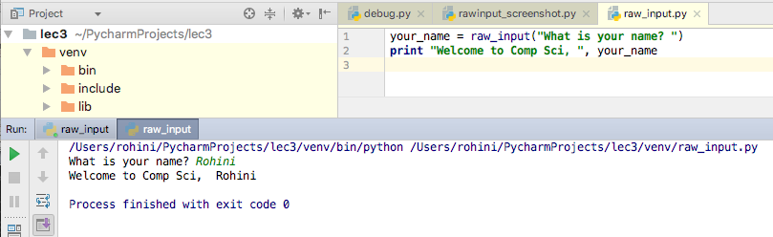
Raw input Example
Notes:
Notice the same format for the print function is used in terms of passing the variable name.
Top: Show the desired value inputted into the console. Press enter when done.
Bottom: Result of the print statement with a raw_input

Slide 40
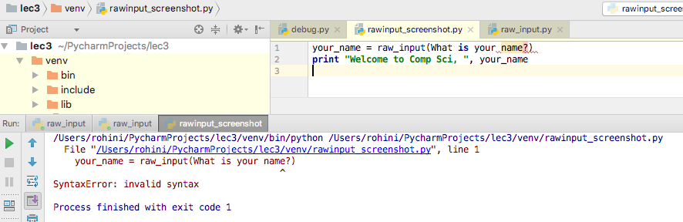
What is wrong?
Notes:
When you are defining the string, you must enclose them in quotation marks
Raw_input(“What is your name?”)

Slide 41
raw_input function problems
Devise TWO questions that store user responses in variables. Print these responses later.
Example
How many siblings do you have? What are their names? Print: You have [number] sibling(s) named [names].

Slide 42
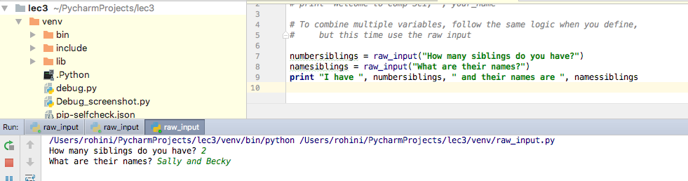
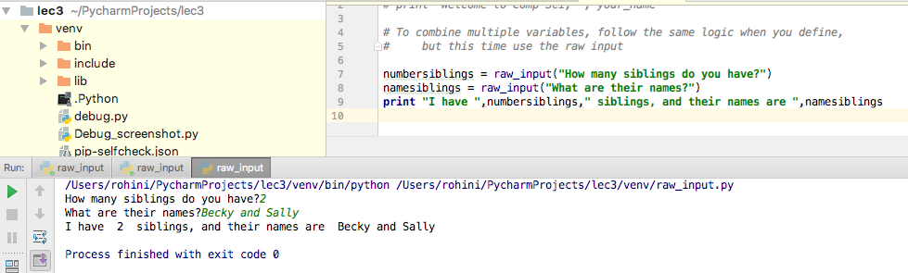
Python Example and Code
Notes:
Declaring the number and names of siblings and by using raw input function, letting the user specify the values
The print function: string phrases are surrounded by quotes, each element is separated by commas
*BE CAREFUL TO COPY THE DECLARED VARIABLE NAME EXACTLY in print function. Otherwise, it will not run

Slide 43
Arithmetic operations
Addition: +
add_var = 8 + 10
print (add_var)
Subtraction: -
sub_var = 8 - 10
print(sub_var)
Multiplication: *
mult_var = 8 * 10
print(mult_var)
Exponent: **
ex_var = 8**2
print(ex_var)
Division
Floating point: /
Integer: //
Why are they different? 10/3 = {3, if integers; 3.333333 if floating point}
Modulus: %
Gets the remainder after dividing.

Slide 44
Arithmetic practice problems
Calculate the mean of at least 3 different values. Print the sum of these values as well as the resulting mean.
Example: let’s say you want to know the average amount of money you spend towards transportation in 3 months.
January = 145.5
February = 88
March = 210.07
Etc.

Slide 45
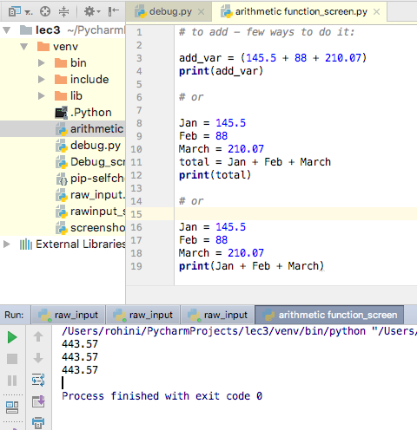
Python example – be flexible to fit your need
Notes:
Top: did the arithmetic function within the variable that was being declared and initialized – input the values directly
Middle: did the arithmetic function on 3 variable after they had been declared and initialized
Bottom: Did the arithmetic within the print statement after declaring and initializing the variables and created a fourth variable to represent the total of the 3 individual variables

Slide 46
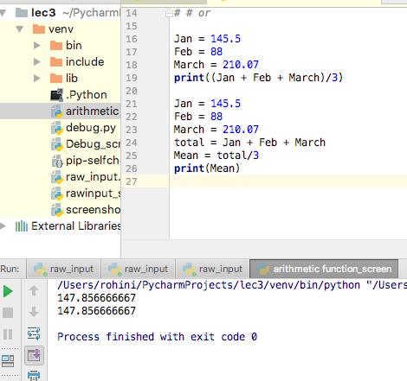
Follows PEMDAS – find mean
Notes:
Can do arithmetic within print function (be careful of PEMDAS and use parentheses appropriately)
Or either define the for the mean and pass that through the print function

Slide 47
Commenting your code
Helps document your code
Guides contributors and readers to better understand functionality of code
Good programming practices…
Represented by ‘#’ in Python
Examples:
# Created by Caroline, 2018
## Next block loops through data and looks for minimum value ##
### Edited by Caroline, 02/13/18. Rohini, please confirm and accept edits ###
And so on…
Take a moment to comment your code so far...
Notes:
On Mac is it is command-backslash

Slide 48
Data Types
How to check?
Python has function type()
var1 = “Caroline”
var2 = 10
var3 = 10.000
print(type(var1)), etc.
Data type is useful for retrieving from memory and for mathematical operations…
Types
Floats (64-bit and 32-bit)
Integers
String
Character (Python does not distinguish, but many other HLLs do…)
Boolean
Hexadecimal
Binary

Slide 49
Type casting (type conversion)
Why do it?
Computational purposes
Example: user input through raw_input function stores value as a string (default behavior).
What if you want to compute an average of multiple user-inputted values?
Convert string to integer or float.
Python handles conversions through functions, similar to print and raw_input
str() -- converts value to string
int() -- converts value to integer
float() -- converts value to floating point number
Notes:
If you ever want to know what type you are working with you can call the type function and pass that value. If we had variable var1, we can:
Print(type(var1))

Slide 50
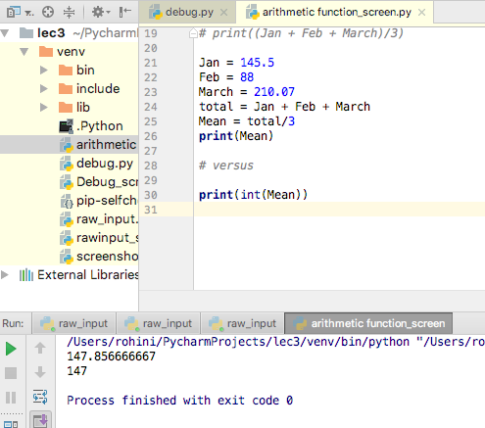
Convert value to integer
Notes:
Notice how in print function we have print(Mean) versus print(int(Mean))
In the second example, I am specifying that I want the output to be in integer format

Slide 51
Type casting problem
Continuation of monthly budget will be continued in Week 4

Slide 52
Take home messages
Organize code by functionality.
Functions are one piece of the organizational schema.
Print to the console
Get input from the console
Data are stored in and retrieved from memory locations through variables.
Data are further categorized by type.
Some types are convertible.
Arithmetic operations
Division
Modulo
Multiplication
Addition
Subtraction

Slide 53
Foundations of Computer Science for Researchers
Week 4

Slide 54
Announcements
Caroline is gone March 7 and March 14
Substitute instructor, Pranay Pareek, for March 14
He will cover the beginning of repetition structures (looping).
Work through problems incorporating loops and conditional statements.
March 7
Practice problems with conditional statements.
Rohini, David, and Charlene will lead.
Optional homework assignments
Will provide practice problems in each week’s code.
Solutions posted week afterward.

Slide 55
Review from Week 3
Functions we’ve learned
Print to the console using print()
Get input from the console using raw_input()
Data are stored in and retrieved from memory locations through variables.
Data are further categorized by type.
Some types are convertible.
int(), str(), float()
Arithmetic operations
Division: / or //
Modulo: %
Multiplication: *
Exponent: **
Addition: +
Subtraction: -

Slide 56
Type casting problem
Modify your solution to the last problem (which asked you to store 3 or more values and calculate the sum and average) → NOW get user input for the three values. Print the final value to the screen.
Hint: raw_input’s default behavior stores values as strings

Slide 57
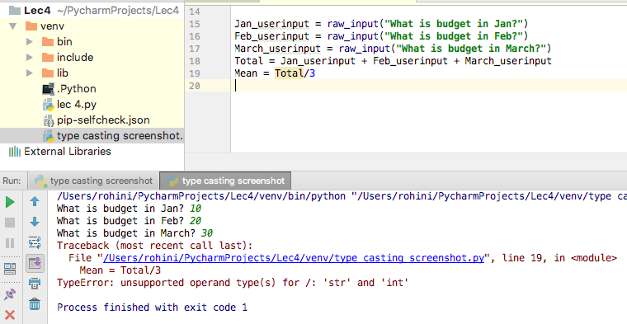
What is wrong?
Try to engage user
by having them
enter values for the
each month
but we get error
Notes:
We are being told there is an issue with the string output and integer request
*REMEMBER raw_input stores as string -> how can we tell it to store the inputted variable as integer instead??

Slide 58
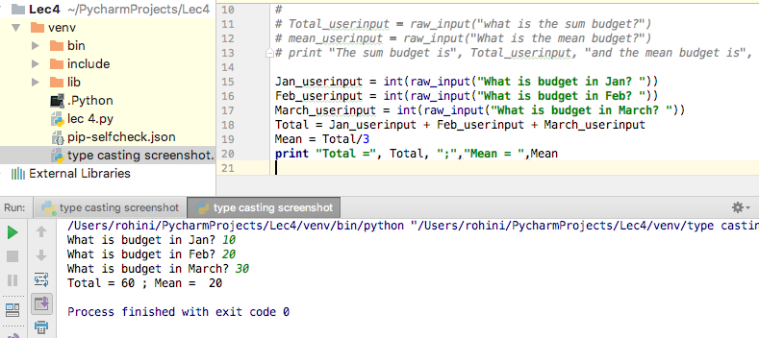
Type-Casting Solution
Notes:
Here we have specified that we want the user input to be read as an INTEGER rather than String
This way, now when we are for the ARITHMETIC addition operation for total and division operation for mean, it can use the user-input

Slide 59
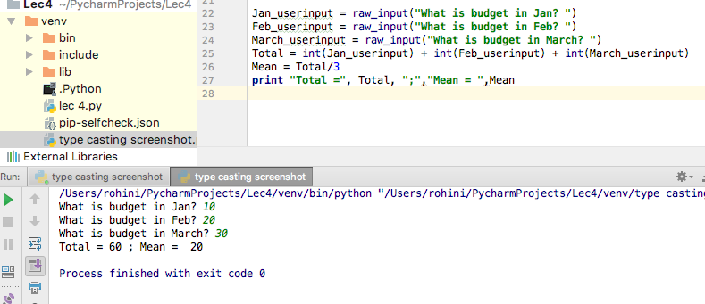
Type-casting alternative solution
Notes:
Here we allow the raw_input to carry out default behavior -> providing string values.
However, when we get to the ARITHMETIC operation portion, we have to specify we need it to be converted into integers

Slide 60
Type casting debugging
var1 = raw_input(“num 1: “) var2 = raw_input(“num 2: “) print float(var1/var2)
Notes:
*Have to specify that the raw_input comes out as an integer -> can’t specify at end. It has to be set up before the value is specified so the program knows how to treat it
Correct Answer:
var1 = int(raw_input(“num 1: “))
Var2 = int(raw_input(“num 2: “))
Print float(var1/var2)

Slide 61
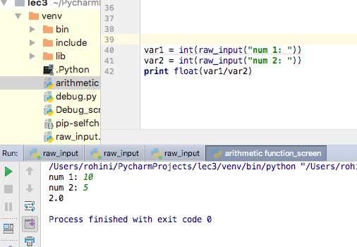

Slide 62
Goals for this lesson
Intro to GitHub
Boolean data
Comparison operators
Logic operators
Conditional statements
One-way, two-way, multi-way if statements
Nested if statements
Library/module imports
Math library
Random number library

Slide 63
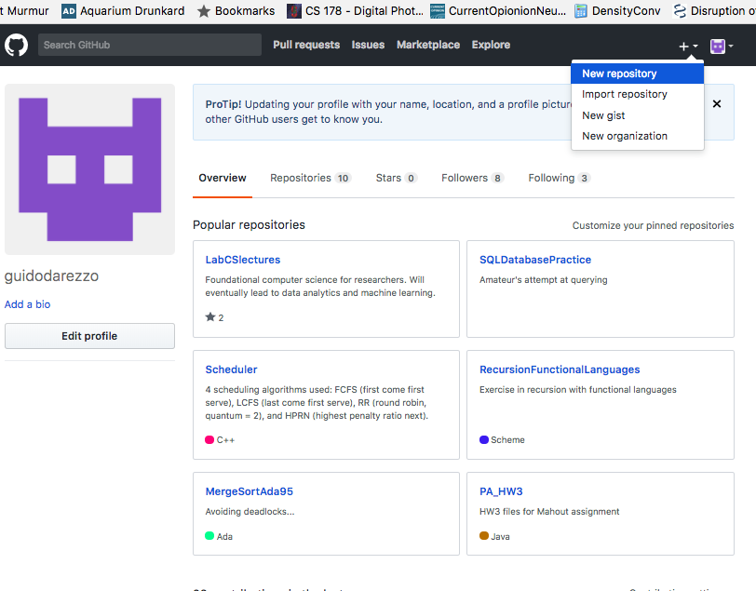
Intro to GitHub
Create a new repository
Multiple files and programmers work under one repository--so it’s a basically an organizational schema for code.
Repositories can be public or private, if you want to restrict access.
Notes:
-

Slide 64
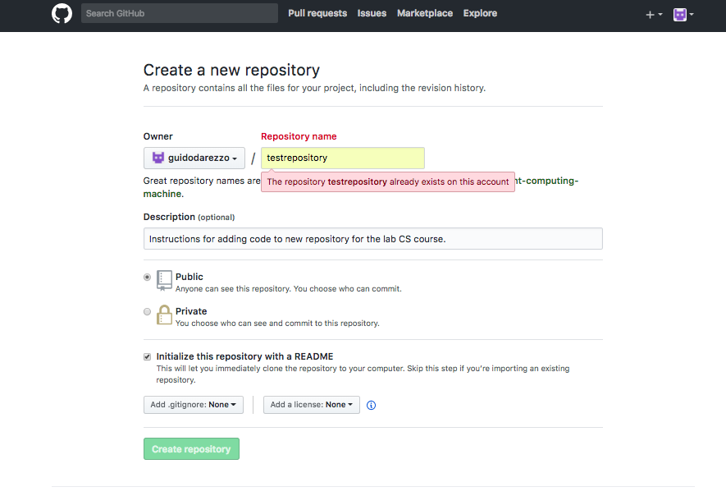
Intro to GitHub
Give your repository a descriptive, succinct name.
Make sure you initialize your repository with a README file.
README files provide information about the project such as how to run it, common bugs, user options, and so forth.
Notes:
README files
These are included with most packages because they provide important runtime and execution information for the user

Slide 65
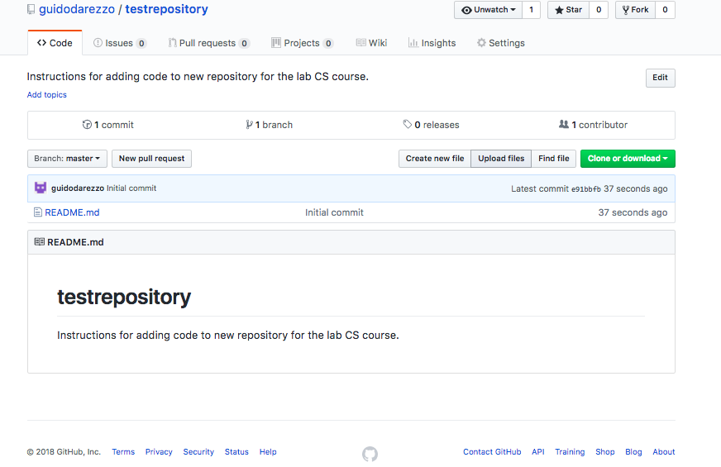
Intro to GitHub
Upload your files by clicking “Upload files.”

Slide 66
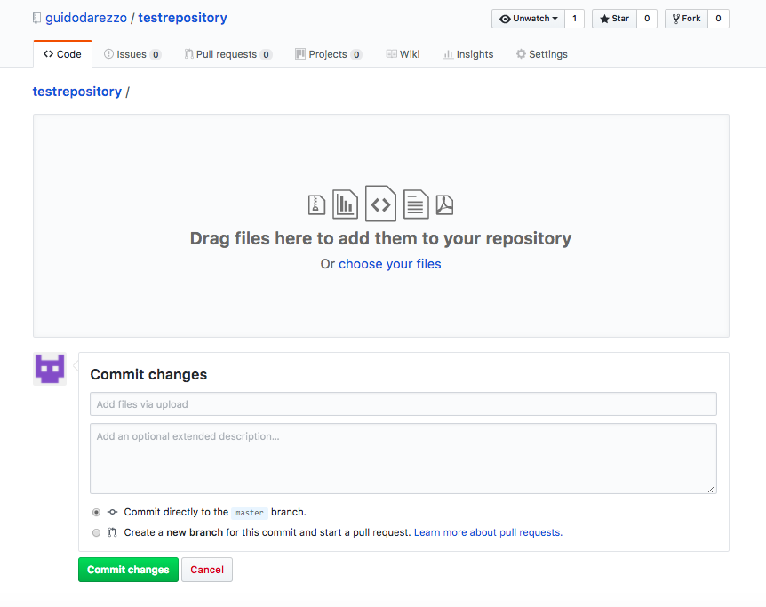
Intro to GitHub
Drag and drop files.
Write a short description of your commit.
A commit is an event that occurs when one or more programmer wants to publish changes to the repository.
Example: added updated slide deck and Week 3 code
Notes:
-the commit -> is an event when one or more programmers publish some changes or notice something to the file uploaded

Slide 67
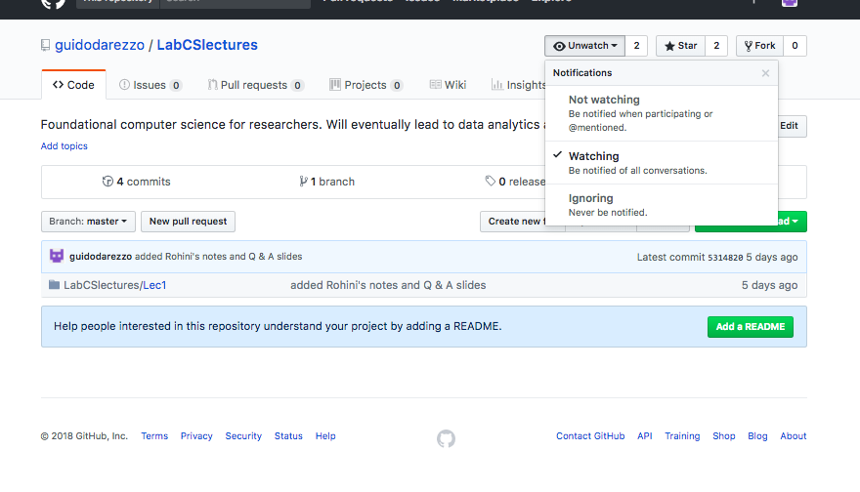
Intro to GitHub
Receive notifications when a repository is updated by watching it.
Notes:
How to move from IDE to GitHUB
IDE stores your files in the USER (name) -> PyCharmProjects -> Folder Name (specified by user when creating project)
-> venv -> pythong file name (specified by user)
Again, Venv stands for virtual envelope = the virtual environment to develop a software

Slide 68
Boolean data types
Boolean expressions yield boolean data, meaning true or false values
5 + 3 > 2 → True
5 + 3 < 2 → False
Use comparison operators in Boolean expressions

Slide 69
Comparison operators
==
Equality
x == y
Are the values of x and y equal to one another?
!=
Inequality
x != y
This expression is true if x is not equal to y
Notes:
Boolean expressions yield Boolean data -> values that can only be true or false

Slide 70
Comparison operators
>
Greater than
x > y
True if x is greater than y
>=
Greater than OR equal to
x >= y
This expression is true if x is greater than OR equal to y

Slide 71
Comparison operators
<
Less than
x < y
True if x is less than y
<=
Greater than OR equal to
x <= y
This expression is true if x is less than OR equal to y

Slide 72
Comparison operators
= and == ARE NOT interchangeable.
Why?
= assigns values from the right-hand side to the variable on the left hand side.
== will yield ONLY Boolean values.
Inequality does not always require LHS and RHS expressions.
Let us assume there exists some integer x, where x > 5.
!x will yield true for any integer less than or equal to 5.
Notes:
= sign signals that the value on the right-hand side of equation is assigned to the variable on the left hand side of equation
== is only TRUE/FALSE output (ie this sign only yields boolean values)

Slide 73
Logic operators
Why are they different from comparison operators?
They allow for multiple Boolean expressions in one statement.
Let’s suppose there are two expressions we want to evaluate: x <= 7; x > 3
In other words, we want to know if x is in range, (3, 7]
Use logic operator, and to evaluate both expressions at once.
x <= 7 and x > 3

Slide 74
Logic operators
AND operator
In Python, we write it as and.
x = 5
x > 3 and x <= 7 yields True
In other languages, and is represented as & or &&

Slide 75
Logic operators
OR operator
In Python, we write it as or.
x = 5
x > 3 or x <= 7 yields True
Other languages differentiate between the exclusive and inclusive or
Exclusive or, ^ or ^^, yields True IFF (if and only if) one of the statements is true, but not both.
Inclusive or, | or ||, yields True when one or more statements are true.
PYTHON USES INCLUSIVE OR

Slide 76
Conditional statements
Statements that guide the behavior of a program based on one or more Boolean statements.
Programs can make their own decisions while it is running.
Dynamic updates of values.
In Python, the syntax is as follows:
if [Boolean expression]:
[block of code to be executed when if statement is true]
One-way, two-way, multi-way, and nested if statements are possible

Slide 77
One-way if statements
Means we have only one if statement to evaluate.
Example:
x = 5
if x > 10:
print “x is greater than 10!”
## Should evaluate to False, thus printing nothing
Notes:
*evaluating if the boolean expression is True.

Slide 78
Two-way if statements
Directs the behavior of the program when the if block is not executed.
If, else used in conjunction
Example:
x = 5
if x > 10:
print “x is greater than 10!”
else:
print “x is less than or equal to 10!”
Notes:
Else is what happens when the “if” is not satisfied

Slide 79
Two-way if statements practice
Write a two-way if statement which prints “Fizz” for even numbers and “Buzz” for odd.

Slide 80
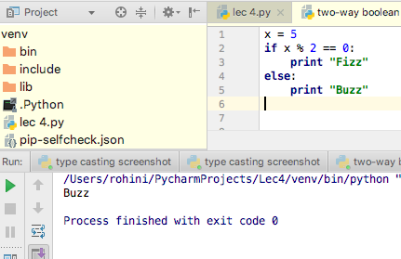
Defining value for x
Notes:
X is even when there is no remainder ie when x is divided by 2, the remainder is 0
Here we defined x to have the value of 5 (an odd number)
Output based on Boolean expressions produced “Buzz” (because we defined an odd number)

Slide 81
User input value for x
Rather than define x, how could you be more dynamic with the input?
Hint: use raw_input.

Slide 82
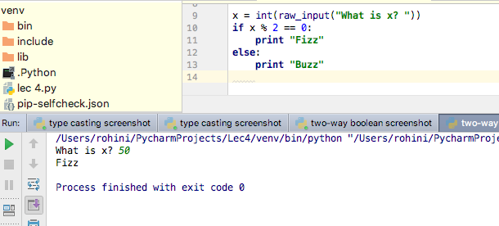
User Input value for x
Notes:
*Need to specify working with integer b/c we have arithmetic operation in Boolean expression
Entered value in console -> output follow Boolean rules

Slide 83
Multi-way if statements
If, elif, else used in conjunction
Example:
x = 5 if x > 10: print “x is greater than 10!” elif x == 10: print “x is equal to 10!” else: print “x is less than 10!”

Slide 84
Multi-way if statement practice
Write a multi-way if statement which prints “x is positive” for positive numbers, “x is negative” for negative numbers, and “x is 0” otherwise.

Slide 85
Nested if statements
Can further distinguish between categories.
if x > 0: if x % 2 == 0: print “Positive even number” else: print “positive odd number” else: if x % 2 == 0: print “negative even number” else: print “negative odd number”

Slide 86
Nested if statements practice
Write a series of nested if statements for student grades. You want to print either pass/fail and followed by the student’s letter grade. Please account for -/+ letter grades.

Slide 87
Take home messages
Use int(), float(), str() to type cast.
Boolean expressions are constructed with comparison operators (==, !=, >, >=, <, <=). Multiple expressions are interconnected using logic operators (and, or, not).
Use one-way, two-way, multi-way, and nested-if statements to guide behavior of your program.

Slide 88
Library imports
Libraries are toolkits for programmer.
Each language has its own libraries.
Libraries are enriched with specialized functions such as cosine, sine, tangent, rounding up and down.
In Python, import statements are declared at the beginning of a module.
Common Python libraries are Math and Random.
Math toolkit gives you rounding functions (ceil, floor), trig functions, factorial, etc.
Random generates random numbers for you.
import math, random
print(math.ceil(7.8)) print(random.randint(1,3))

Slide 89
QUESTIONS:
1. Since Python uses inclusive or, is there way to use exclusive or and if so how?

Slide 90
Foundations of Computer Science for Researchers
Week 5

Slide 91
One-way if statements
Means we have only one if statement to evaluate.
Example:
x = 5
if x > 10:
print “x is greater than 10!”
## Should evaluate to False, thus printing nothing
Notes:
*evaluating if the boolean expression is True.

Slide 92
Two-way if statements
Directs the behavior of the program when the if block is not executed.
If, else used in conjunction
Example:
x = 5
if x > 10:
print “x is greater than 10!”
else:
print “x is less than or equal to 10!”
Notes:
**Else is what happens when the “if” is not satisfied

Slide 93
Two-way if statements practice
Write a two-way if statement which prints “Fizz” for even numbers and “Buzz” for odd.

Slide 94
Defining value for x
Notes:
X is even when there is no remainder ie when x is divided by 2, the remainder is 0
Here we defined x to have the value of 5 (an odd number)
Output based on Boolean expressions produced “Buzz” (because we defined an odd number)

Slide 95
User input value for x
Rather than define x, how could you be more dynamic with the input?
Hint: use raw_input.

Slide 96
User Input value for x
Notes:
*Need to specify working with integer b/c we have arithmetic operation in Boolean expression
Entered value in console -> output follow Boolean rules

Slide 97
Two-way Statements Practice
Duck, duck, goose!
Store your own name in a variable. Ask the user for his/her name. Print goose if the user's name matches yours; otherwise, print duck.
Notes:
The point of this exercise is to familiarize ourselves with string comparisons.
Up until now, we have only compared numeric values. Please think about other intances in which string comparisons can be useful.
Define stored variables before userinput
BE MINDFUL OF USER INPUT AND CREATING ANY NEW VALUE (SPACES ARE REGISTERED, AND CASE SENSITIVITY)
IF YOU SET UP BOOLEAN AS STRING WHY DOES IT NEED TO BE SPECIFIED

Slide 98
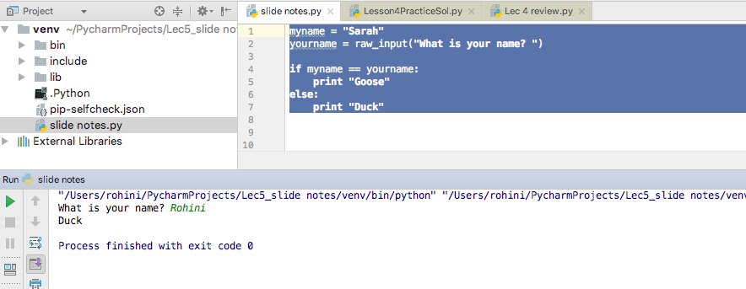
Duck, Duck, Goose Solution
Notes:
Define stored variables before userinput!
BE MINDFUL OF USER INPUT AND CREATING ANY NEW VALUE (SPACES ARE REGISTERED, AND CASE SENSITIVITY)
IF YOU SET UP BOOLEAN AS STRING WHY DOES IT NEED TO BE SPECIFIED? (questions answered at end of slide deck)

Slide 99
Two-way statement practice – Lost Pet
You are searching for your missing pet, whose name is Barry and he is a monkey (stored variables). You have put up flyers, and people are calling you to report a lost pet they have found.
You need to confirm the found pet name and species (through user input) and compare it to your pet’s name and species (two-way bolean statements) in order to see if it is your pet that has been found (two different print statement based on boolean, such as you have found my pet, Barry or You have not found my pet, Barry).
Hint: There will be 4 variables that need to be declared (your pet’s name and species, and the found pet’s name and species)

Slide 100
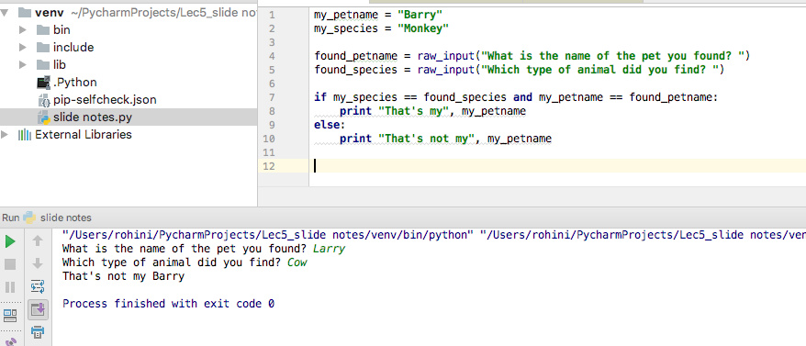
Notes:
*Notice the way to connect two statements by use of “AND”

Slide 101
Goals for this lesson
Finish up conditional statements
Multi-way and nested if statements
Library imports
Practice problems
Lesson5.py homework problems
OR choose a self-report questionnaire and turn it into a series of if statements.
OR turn TAB or ART screening into if statements.

Slide 102
Multi-way if statements
If, elif, else used in conjunction
Example:
x = 5 if x > 10: print “x is greater than 10!” elif x == 10: print “x is equal to 10!” else: print “x is less than 10!”

Slide 103
Multi-way if statement practice
Write a multi-way if statement which prints “x is positive” for positive numbers, “x is negative” for negative numbers, and “x is 0” otherwise.

Slide 104
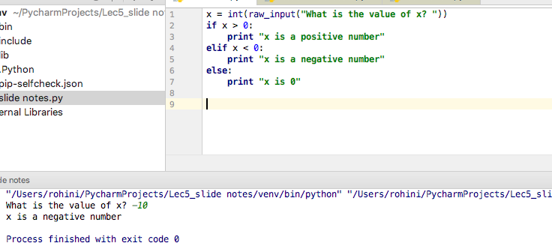
Notes:
*Always try a few userinput values to make sure the whole code works (ie don’t just try one positive number, rather try a positive number and a negative number/ or a negative number and 0)

Slide 105
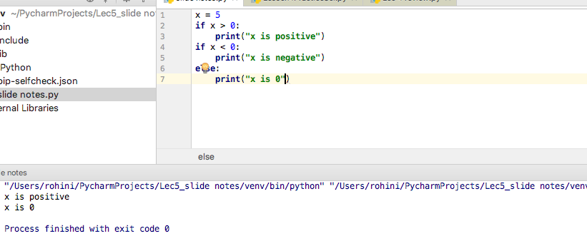
Great Example Demonstrating the need for elif
Notes:
As you can see here – two solutions appeared. The reason is because two if statements were used rather than the elif.
Here the code ran to see if the first if statement was upheld (if x is positive), and it was true. BUT THEN, it saw a “new” different scenario where the value of x should be compared to either a negative number or all else and thus printed 0 as well.
As you can see, elif makes sure that the elif statement is conditional on the first if statement.

Slide 106
Nested if statements
Can further distinguish between categories.
Kind of like asking follow-up questions...

Slide 107
Nested if statements
if x > 0: if x % 2 == 0: print “positive even number” else: print “positive odd number”
elif x == 0: print “x is 0” else: if x % 2 == 0: print “negative even number” else: print “negative odd number”

Slide 108
Nested if statements practice
You received a 88.3, 95.7 and 96 on three exams. You want to see what your grade average is and what letter grade that translates to.
Ask the user to input the exam grades, and then calculate the average from that.
Write a series of nested if statements for student grades (broad category is A, B, C, D, F -> nested statements (if, elif, else) will be whether you get a A+, A, or A-, etc). You want to print “Your final grade is: [grade]. Use metrics below:
If you received above or equal to 89.5 you get an A
Use general cutoff for +/- grades: above 97.5 = A+, above 93.5 = A, above 89.5 = A-
below 89.5 and above and equal to 79.5, you get B
between 79.5 and above or equal to 69.5, you get C
below 69.5 and above or equal to 59.5, you get a D
Below 59.5 you get a F

Slide 109
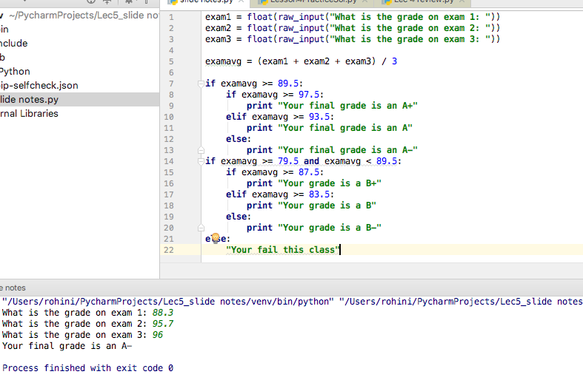
Notes:
Note here – we have multiple if statements, but the grades are clearly given boundaries.
HOW COULD YOU CONCEPTUALIZE THIS PROBLEM WITH ELIF STATEMENTS INSTEAD?
(compare this circled portion to next slide)

Slide 110
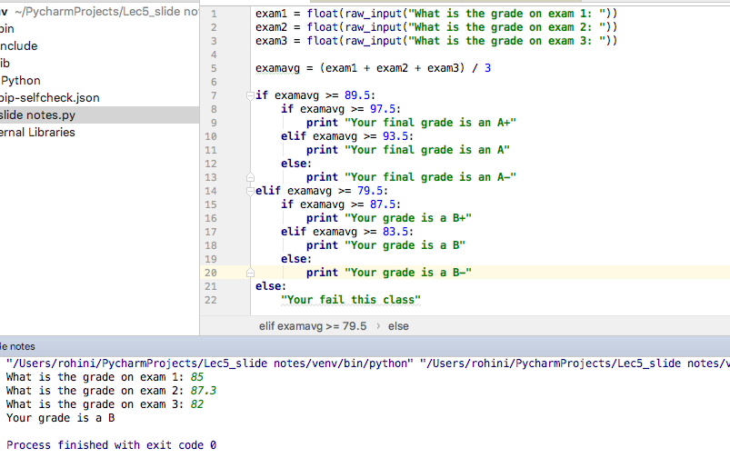
SOLUTION IF USING ELIF INSTEAD
Notes:
Elif allowed us to not have to place strict boundaries on the statement and rather could just place the lower boundary of the grade!

Slide 111
Library imports
Libraries are toolkits for programmer.
Each language has its own libraries.
Libraries are enriched with specialized functions such as cosine, sine, tangent, rounding up and down.
In Python, import statements are declared at the beginning of a module.
Common Python libraries are Math and Random.
Math toolkit gives you rounding functions (ceil, floor), trig functions, factorial, etc.
Random generates random numbers for you.
Documentation

Slide 112
Library imports
import math, random
print(math.ceil(7.8))
## change the integers in the parentheses if you want to adjust the range print(random.randint(1,3))
**additional examples in code
Try it yourself!
Look at the documentation, see what you can do.

Slide 113
Die Roll – You are the winner…
You and your friend are rolling a die (die outcomes are random). The winner is determined by the higher number.
Write a program that generates die rolls for you and a friend (you will need a randomly generated number for you and your friend), and subsequently determines the winner (mutli-way boolean statements)

Slide 114
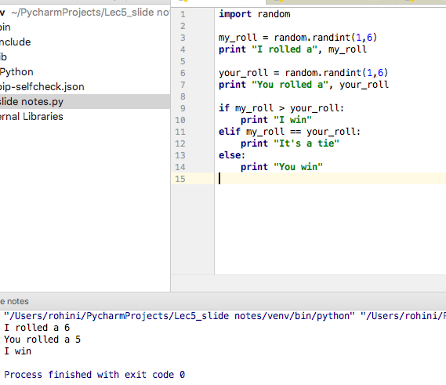
Notes:
If you want to see the results of the randomizer, you can use a print statement to display it!

Slide 115
Questions for Caroline
In the Duck, Duck, Goose example - if we don’t specify space, it registers as always true? Or we have to specify str() in Boolean statement? Why?

Slide 116
HOMEWORK – PRACTICE PROBLEMS
On next slides

Slide 117
Multi-way Statement Practice – Cash Register
You are at a cash register purchasing some groceries. You want to know if you have given enough cash, need to give more, or gave just enough.
Ask the user to input the price of the three grocery items you are getting. Ask the user to input the cash you are giving as well (can be a random number). How will the user tell me whether I have given enough cash, too much, or too little?
Hint: to start: grocery items can be valued at $5, $10, $15, and the cash being given is $45.
Hint: the Boolean statement (if statements) will have to compare the cash given to the price of the items (new variable to be defined), and evaluate whether there is change to be given back (if), money to be owed (elif), or the perfect amount (else).

Slide 118
Multi-way Practice – Chores
Let's say the program is going to assign one of three types of chores (sweeping the floor, dishes, dusting the piano) based on the number the you choose.
Have the user input his/her name and an integer between 1 and 99. Based on this number, they will be assigned one of three tasks (think how to create Boolean statements that differentiate the number choosen. Hint on next slide)
Make you assign a task to user by printing out his/her name and the task.
Notes:
*hint you can use a Random library import or the function “rand_int” function

Slide 119
Hint for Chore
For the number picked:
if it is a number divisible by 3, they get one chore
if number is divisible by 3, but have a remainder of 1, they get the other chore
all else they get the third chore

Slide 120
Multi-way Practice –Which coin
Write a program that asks the user for the value of a coin (1, 5, 10, 25)
Create a multi-way program that uses the type of coin value entered to identify the type of coin it is (penny, nickel, etc)
If the user inputs 25, your program should identify that this is a quarter, etc all the way to a penny

Slide 121
Multi-way practice (library import)
Write a program that outputs at least 4 different results of a magic 8 ball based on the number you get
ie you magic eight ball may come back saying “You may rely on it”, “Yes, this will happen”, “Ask me again later”, “Outlook not so good” HINT: use modulus OR the random number library to determine the output.

Slide 122
Foundations of Computer Science for Researchers
Week 6

Slide 123
Goals for this lesson
Shortcut operators
Begin learning about repetition/iteration structures.
While loops (primary focus of this lesson)
For loops
Nested loops

Slide 124
Shortcut operators
Let’s start with x = 10
+=
Add value from RHS to value on the LHS.
x += 1, we will get 11, 12, 13, 14, and so on…
Equivalent to x = x + 1
-=
Subtract values from LHS by value on RHS.
x -= 1, we will get 9, 8, 7, 6, and so on…
Equivalent to x = x - 1
*=
Multiply values on LHS by value on RHS
x *= 2, we will get 20, 40, 80, 160, and so on...
Equivalent to x = x * 2

Slide 125
Shortcut operators
Let’s start with x = 40
/=
Add divide value on LHS by value on RHS.
x /= 2, we will get 20, 10, 5, and so on…
Equivalent to x = x / 2
%=
Get modulus of value on LHS by the value on RHS.
x %= 3 we will get 1, 1, 1, and so on…
Equivalent to x = x % 3

Slide 126
Iteration structures
Used to repetitively perform some action until termination condition is satisfied.
Components are initialization, termination condition, and update.
Notes:
When you want to use as few lines of code as possible to execute the same function over and over again
Initialization -> will be some “counter value” (i.e. counter = 0)
Termination Condition -> “body of loop”
“while counter XXX” -> tells loop at what point to keep running
3) Update condition:
- how the loop progresses
ie “counter +=1 (from initialization value the loop will move from that value by 1 until termination)

Slide 127
While loops
## initialize some variable. counter = 0
## write the termination condition of your while loop while counter < 5: print “counter =”, counter ## now update the value of counter counter += 1
How many times will this loop print counter? Try it out...
Notes:
--Use iteration structure to repeatedly perform same action until some set pre-condition has been satisfied

Slide 128
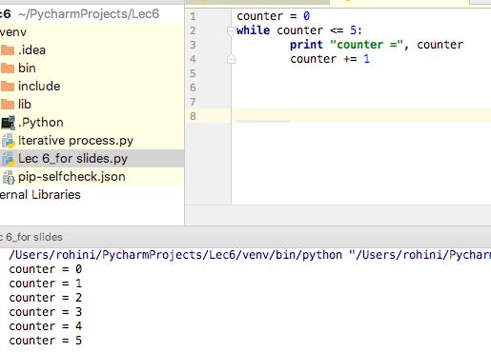
Notes:
Initialization: counter = 0
Termination: While counter <= 5
Update: counter +=1
Loop Logic:
I would like to start at 0 (initialization) -> I want the loop to run up until the counter gets to 5 (termination) ->
I would the counter to increase by 1 (update).
So, I start at 0. Is 0 less than or equal to 5? -> YES -> So, it will print counter = 0.
Then, I want to increase counter by 1, which gives me the counter value = 1.
Is counter = 1 less than or equal to 5 -> YES -> so it will print counter = 1
This will go on until the counter value exceeds 5 at which point it will NOT print and will stop.

Slide 129
While loops
The loop will terminate when the termination condition is satisfied.
What happens when we do not update?
Loop will go on infinitely…
Updating ensures that we will satisfy the termination condition at some preset event.
What if we never initialize?
We will never start the loop.
Or, dependent upon the program structure, the loop will execute infinitely.
Notes:
Question: Why is update placed after termination?
If you don’t properly update, it will go on infinitely. You need to tell program when to end, so that it tests the termination to the update rule to see if it is satisfied or not
Ie the counter value output will be tested against the termination sequence before being printed

Slide 130
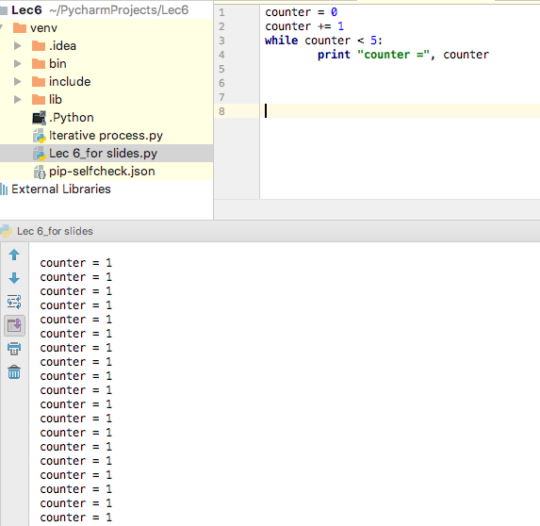
Example of incorrect loop
Notes:
This is incorrect in terms of placement of update statement and termination statement
Here the sequence runs infinitely
WHY? Let’s go over Loop Logic:
I would like to start at 0 -> I am going to increase from 0 by 1 -> however you don’t know when to stop
And it continues to run by adding one FOREVER.
->Basically, we have to pre-set when to end before you run it

Slide 131
While loop practice problem
Write a program where you print the counter value 5 times. If the counter is even, print “Fizz!” If the counter is odd, print “Buzz!”
Incorporate your understanding of conditional statements into your loop.

Slide 132
While loop practice problem
## initialize! counter = 0
## termination condition!! while counter < 5: print counter if (counter % 2) == 0: print “Fizz!” else: print “Buzz!”
## update!!! counter += 1

Slide 133
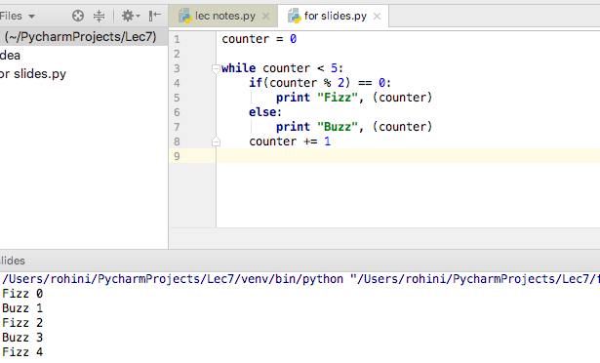
Notes:
Starting value to begin at is 0
Loop will run as long as value is less than 5 (to follow instructions to run loop 5 times)
Loop will run the counter value through Boolean statement (even/odd)
And will add 1 to counter each iteration

Slide 134
While loop practice problem
Let us transform a problem from earlier, which queried the user for monthly transportation expenditure and outputted the monthly average.
Ask the user how much he/she/they spent in a month. Do this three times. Calculate the average and print it out to the console.

Slide 135
While loop practice problem
total = 0
## initialize!
counter = 0
## termination condition!!
while counter < 3:
print "Month", counter + 1
total += float(raw_input("How much on transportation this month? "))
## update!!!
counter += 1
print "In the last three months, you spent an average of", total / 3, "per month"

Slide 136
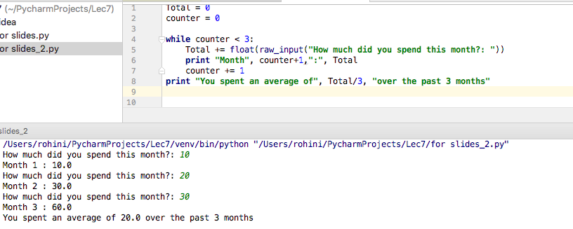
Notes:
**NOTE HOW WE INCLUDED USER INPUT INTO THE LOOP

Slide 137
While loops practice problem
Write a program where you calculate exponentials for the user. Ask the user for the base number and its exponent. Calculate the answer using a loop, and print the result of each iteration.

Slide 138
While loops
base = int(raw_input(“Enter the base: “)) exp = int(raw_intput(“Enter the exponent: “)) ## Initialize counter = 0 result = 1 ## termination condition while counter < exp: result = result * base print results ## update! counter += 1

Slide 139
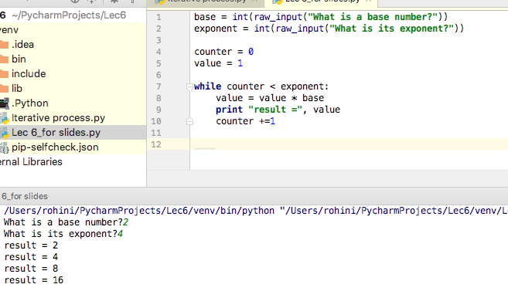
Notes:
**KEY THINGS TO REMEMBER.
1) when you have an equation like value = value * base -> the IDE reads this from RIGHT TO LEFT.
2) the initialization step is just to get the loop started, after that the loop operates independently of the initialization until termination criteria is hit.
Loop Logic:
Set two initialization values (ie starting values) for the counter (how exponents you want to run) and the initial value to multiply the base by. In this example I want to see every iteration of 2^4.
First sequence: counter = 0. This is less than 4 (exponent). So we can run the loop: which says
First line *REMEMBER TO READ RIGHT TO LEFT. So the value is going to equal 1 * 2
Will print: result = 2
Then update counter to 0 + 1 = 1
Second sequence (now within loop only): So is counter (1) < 4 -> YES -> we can run the loop
First line: the value is now 2 * 2 (base) which equals a new value of 4
The is the WHOLE POINT OF A LOOP. It allows us to iteratively updated the LHS value
Will print result = 4
Then update counter to 1 + 1 = 2
Third sequence: coutner is now 2 which is < 4 -> so we can run the loop
First line: the value is now 4 * 2 which equals new value of 8
Will print result = 8
Updated counter so that is now 2 + 1 = 3
Fourth sequence: counter is now 3 which is < 4 -> we can run the loop
First lne: the value is now 8 * 2 which equals the new LHS value of 16
Will print result = 16
Update counter so that is now 3 + 1 = 4
Termination: now the counter is 4 which is NOT less than 4 so the loop ends.

Slide 140
While loops practice problem
Write a program to calculate 5 factorial.
Notes:
### Give them 7 - 10 minutes to solve this. See code for this answer ###

Slide 141
While loops practice problem
fac = 5 ## Initialize! counter = 4 ## termination condition! while counter > 0: fac *= counter print fac ## update! counter -= 1
Notes:
### Give them 7 - 10 minutes to solve this. See code for this answer ###

Slide 142
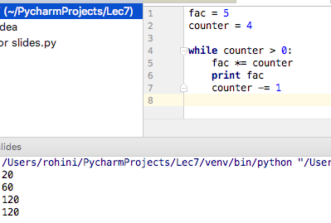
Notes:
Here our objective is to get to a value of 5!
We know we want our base to be 5 and every number chronological down to 1 to be multiplied to each other. So that 4 , 3, 2, 1 OR 4 numbers giving us a counter of 4
LOOP LOGIC:
First sequence: Starting with counter = 4 which is >0 -> we can run loop
The fac here is = 5 (initialization) and we want to multiply it to counter -> 5 * 4 = 20
Print the fac result which is 20
Counter updates so that is is 4 – 1 = 3
Second sequence: starting with counter = 3 which is > 0 -> we can run loop
The fac here is NOW 20 * 3 (the counter in this sequence) -> 20 * 3 = 60
Print the fac result for this loop = 60
Update so counter is now 3 – 1 = 2
Third sequence: counter is now 2 which is > 0 -> we can run loop
Fact is NOW 60 * 2 (counter in this sequence) -> 60 * 2 = 120
Print fac result of this loop = 120
Updates so counter is now 2 – 1 = 1
Fourth sequence: counter is now 1 which is > 0 → we can run loop
The fac here is NOW 120 * 1 (counter is this loop) -> 120 * 1 = 120
Print fac result for this loop = 120
Update counter so is now 1 – 1 = 0
Termination sequence: counter is now 0 which is NOT > 0 so the loop ends.
5! = 120 and we see each step along way
5* 4 = 20
5* 4* 3 = 60
5* 4* 3* 2 = 120
5* 4* 3* 2* 1 = 120

Slide 143
Additional Practice:
Add numbers in a sequence until the maximum integer by user input is met
I.e. is user input specifies maximum integer to be 5, final result should be:
1 + 2 + 3 + 4 + 5 = 15

Slide 144
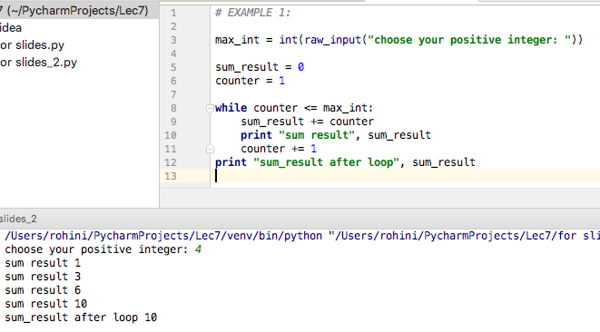
This allows you to demonstrate the final result of the loop
Notes:
Starting Value:
The starting sum is going to be 0 b/c nothing has been added together yet
You are starting with the lowest number: 1
Based on User Input – we want to add all the numbers from 1 to 4 together (ie 1 + 2+ 3+ 4)
LOOP LOGIC:
First sequence: start with number 1 which is less than 4 -> we can run loop
0 will be added to 1
The sum when you have just one number is that number so will print: sum result = 1
Update: counter will be updated 1 + 1 = 2
Second sequence: counter is now 2 which is < than 4 -> we can run loop
Sum_result is NOW 1 + 2 (counter in this loop) -> 1 + 2 = 3
Will print the the sum_result for this loop (3)
Update counter will be 2 + 1 = 3
Third sequence: counter is now 3 whichc is less than 4 -> we can run loop
The sum result is NOW 3 + 3 (counter in this loop) → 3 + 3 = 6
Will print sum_result for this loop = 6
Update counter for next loop will be 3 + 1 = 4
Fourth sequence: coutner is now 4 which is <= to 4 → run loop
The sum result is NOW 6 + 4 (counter in this loop) → 6 + 4 = 10
Will print sum result for this loop = 10
Update counter for next loop = 4 + 1 = 5
Termination: the counter is now 5 which is NOT less than or equal to 4 so loop ends.
IF YOU WANT TO GET FINAL VALUE OF THE LOOP -> WRITE THE PRINT FUNCTION OUTSIDE OF THE LOOP (LAST LINE IN CODE)

Slide 145
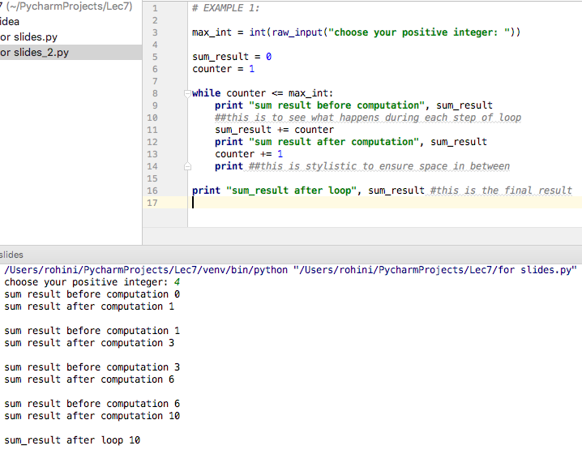
To be able to see each step – print as often as you can
This step is basically showing you the original sum_result and then what happens when you apply the loop rule to get new result
i.e. it was sum_result = 1 was from the last loop and when you add the counter value of 2 you get the result 3 (to depict the “1 + 2” step of the “1+2+3+4” goal

Slide 146
Helpful DEBUGGING TIPS:
Look at breakpoints and print as often as you can
To set up a breakpoint:
Click in the space in between row number and code -> a red circle will appear
To run in debugging mode -> Right click on input screen and click “Debug the python file”
A debugger window will open up in same location as console.
You will notice icons in the top row of this window that you can hover over to ee their names/functions
Click “Step into” -> For loops it will go through each step of the code you wrote
The console (which shows print) will follow the step through so you can match the line of code with your outcome and see if it aligns

Slide 147
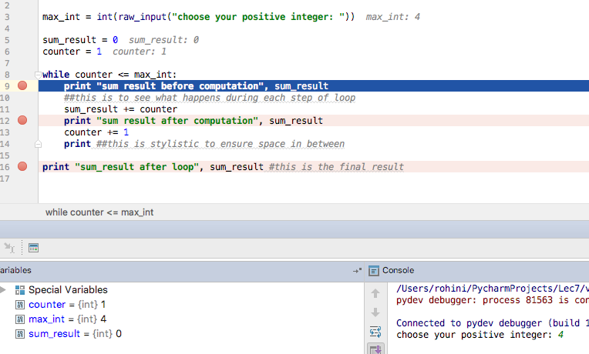
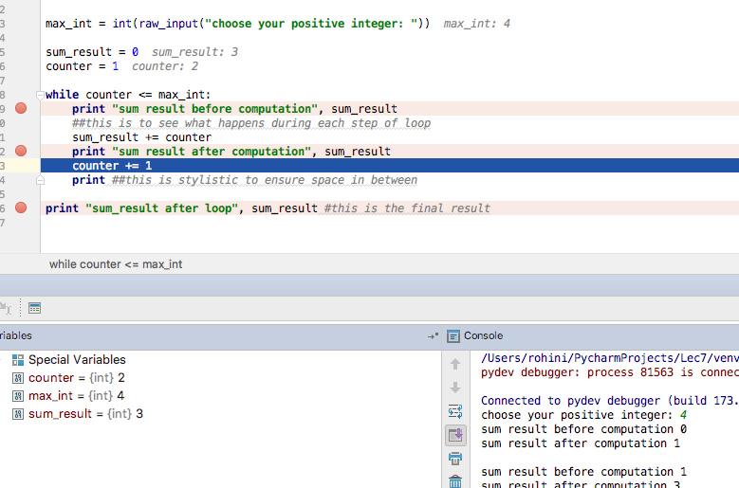
Notes:
Back screen shows first sequence, while left window shows second sequence and the console updating as it goes along

Slide 148
Take home messages
Initialize, set the termination condition, UPDATE
Think about why, why, why we need these steps…
Use loops for repetitive actions
Asking for user input
Performing calculations
What else?

